Slide 1
New York City Airbnb Market Analysis
Presented By : NITA J
Data Analyst

Slide 2
Agenda
BUSINESS PROBLEM
DATASET OVERVIEW
DATA CLEANING
FEATURE ENGINEERING
DAX Measures
LIVE DEMOSTRATION
Market Overview
Location Analysis
Room & Pricing
Host Performance
Reviews & Availability
Recommendations
Conclusion
Q & ANS

Slide 3
BUSINESS PROBLEM
The main purpose of this project is to understand the Airbnb market, compare prices across neighbourhoods, analyse host performance and study customer review activity.
The dataset allows me to study :
where listings are located?
how much they cost?
what type of rooms are offered?
how hosts manage their listings?
Which neighbourhoods have higher average prices?
How are reviews distributed across the market?

Slide 4
DATASET OVERVIEW
MAIN COLUMN DATA TYPE room_type Text price whole number minimum_nights whole number number_of_reviews whole number last_review Date reviews_per_month Decimal Number calculated_host_listings_count whole number availability_365 whole number Total Number of Columns : 16 Total Number of Rows : 49,080

Slide 5
DATA CLEANING
• Promoted the first row as the column headers.
• Changed the columns to the correct data types.
• Removed duplicate listing IDs.
• Trimmed text and replaced missing names with 'Unknown'.
• Replaced missing reviews_per_month values with 0.
• Removed zero-price records and invalid price errors.
• Checked errors in IDs, coordinates, review counts and dates.
• Kept valid high prices and high minimum-night values instead of treating them as errors.

Slide 6
FEATURE ENGINEERING
Price Category
Budget: Price up to 300
Standard: Price above 300 and up to 1,000
Premium: Price above 1,000 and up to 5,000
Luxury: Price above 5,000
Availability Category
Low Availability: Up to 90 days
Medium Availability: 91–180 days
High Availability: 181–300 days
Very High Availability: More than 300 days
• Review Year, Review Month and Review Quarter from last_review.
• Host Portfolio Size — 1, 2–5, 6–10, 11–20 and 21+ listings.

Slide 7
DAX Measures
• Total Listings = DISTINCTCOUNT(id)
• Total Hosts = DISTINCTCOUNT(host_id)
• Average Price = AVERAGE(price)
• Total Reviews = SUM(number_of_reviews)
• Average Reviews per Listing = Total Reviews ÷ Total Listings
• Average Availability = AVERAGE(availability_365)
• Average Minimum Nights = AVERAGE(minimum_nights)
• Average Listings per Host = Total Listings ÷ Total Hosts

Slide 8
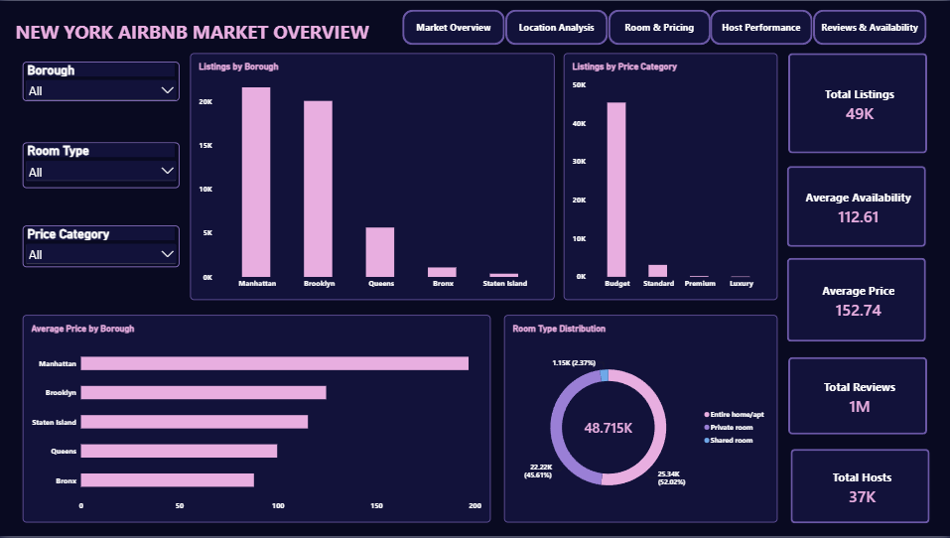
LIVE DEMOSTRATION

Slide 9
Market Overview
Manhattan and Brooklyn has 44.3 % & 41.7 % of listings - Hosts may face strong competition.
Staten Island & Brooklyn 2.2 % & 0.8 % - Examine the transport accessibility.
Budget listings dominate the platform - Compare similar platforms by locations & room type befor e setting price.
Manhattan ( 58%) & Brooklyn ( 40%) - Location, visitor demand, property may influence prices.
Entire homes prefer privacy - promoting affordable private offers

Slide 10
Location Analysis
Fort Wadsworth (800 Average Price) & Woodrow come under staten island - low listings & price increse the average.
Higher prices may reflect property characteristics, limited supply or local demand
Manhattan and Brooklyn have the largest number of listings across room types - Make sure of services & Maintain the quality
Williamsburg and Bedford-Stuyvesant lead the listings - Monitor competition and service quality , investigate demand before expanding elsewhere,Sustainable growth.

Slide 11
Room & Pricing
The scatter plot compares minimum nights and price for individual listings grouped by listing ID.
Entire homes/apartments(8.5 days) have the highest average minimum-night requirement - Prefer Offers.
Room type - consistent checking prices of near by hosts.
Entire homes/apartments have the highest average price (210), private rooms (90) and shared rooms ( 70) - Compare prices within each room type and neighbourhood.

Slide 12
Host Performance
Sonder - Average list (327) & Average reviews (3.9)
Dona - Average list (2) & Average reviews (602)
Better guest experiences and potential review growth, Monitor portfolio-wide quality and availability,Better guest engagement and potentially more reviews.
Lot of hosts are single hosts.
The platform has approximately 37K hosts, an average of 1.30 listings per host and 23.25 reviews per listing.

Slide 13
Reviews & Availability
2018 has highest reviews.
Availability alone does not determine guest reviews; demand, location, quality and booking frequency may also matter - improvements in listing visibility and guest appeal.
Brooklyn has highest review but 2nd in listings.
Average Avalaible days shared room ( 160 days) - Hosta offers packages.
Low-availability listings(UP TO 90) form the largest group, followed by very-high(ABOVE 300 DAYS), high and medium availability - Tickets are unavailable or hosts blocked ticket should be investigated.

Slide 14
Recommendations
Improve Listing Coverage: Promote Airbnb hosting opportunities in areas with fewer listings, such as the Bronx and Staten Island, after checking local demand.
Optimize Pricing: Encourage hosts to compare prices with similar properties in the same neighbourhood and room type.
Improve Guest Experience: Help hosts improve cleanliness, communication and listing descriptions to encourage positive reviews.
Support Small Hosts: Provide simple guidance on pricing, availability management and property presentation to hosts managing one listing.
Review Availability: Investigate listings with high availability and low review counts to identify possible booking or visibility issues.

Slide 15
Conclusion
This project converts Airbnb listing data into useful business insights using Power BI. These insights can help management make better decisions about pricing, host support, guest experience and future market growth.
Manhattan and Brooklyn have the highest listing volumes in the displayed borough comparison.
Entire homes/apartments have the highest average price among the three room types.
Most hosts manage a single listing, while a smaller number manage larger portfolios.
Listing availability and review counts vary across room types and locations.

Slide 16
THANK YOU
Q & ANS ?

